Slide 1

Infrared alert system with radio frequency capability
T09-Signal senderS
Max Cope
Leslie Eide
Chris Klupenger
SignalSenders

Slide 2
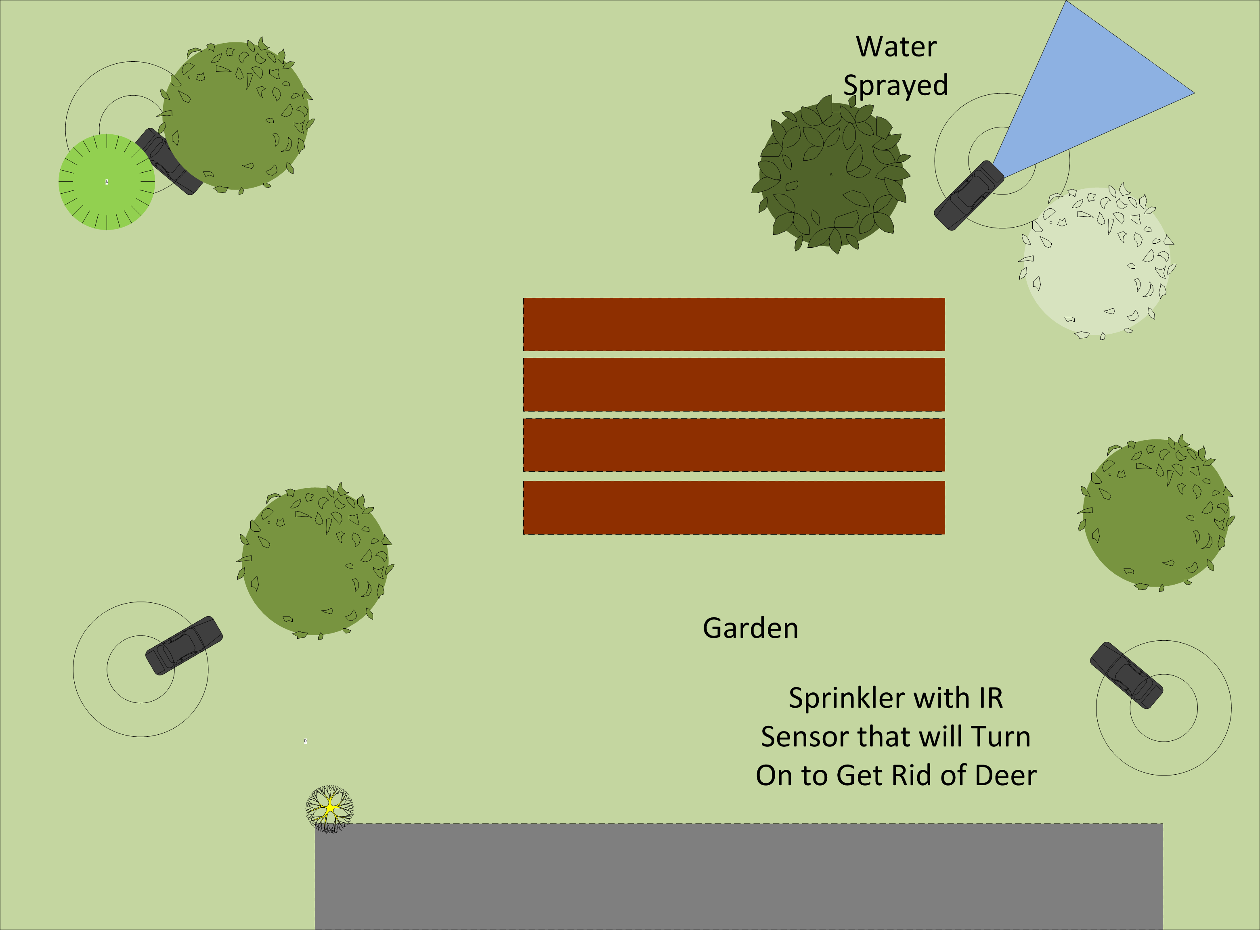
Problem
Practicum Project Guidelines
Motivation
Originated from Sprinklers Systems Designed to Keep Deer off Property
The Systems Lacked Many Features
Communication Between Units
Timers
SignalSenders

Slide 3
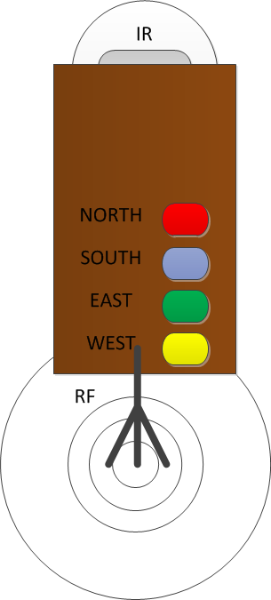
Objective
Develop a Security Network with Communication Capabilities
Utilize Communication within the 2.4GHz ISM band to lessen complexity
Battery Operated to Eliminate Hard Wired Constrictions
SignalSenders

Slide 4
Alternatives
Wired UNITS
Signal Options
Inefficient at larger ranges
Cables everywhere
WIFI
Bluetooth
RF Signals
IR Signal
SignalSenders

Slide 5
Requirements
Motion Sensor
microcontroller
Signal
Used to sense motion within a specified range
Signal used to send specified signal to microcontroller for further processing
Central to the operation of this system
Takes signal from IR and tells the RF module to send a signal that it detected motion
Takes signal from RF module that another unit sensed motion and light up the corresponding LED associated with the unit ID
In standby listening for a signal from the other units to send to the microcontroller
When prompted from the Microcontroller a signal with unit ID is transmitted to the other units
SignalSenders

Slide 6
Approach
Change to something other than interrupt.
Interaction View
Change to 1 pin
Activity View
Change to 5 pin spi
SignalSenders

Slide 7
Design
Identifying the Appropriate
Motion Detector
Microcontroller
RF Transceiver
LED Indicators
Battery Power
Housing
SignalSenders

Slide 8
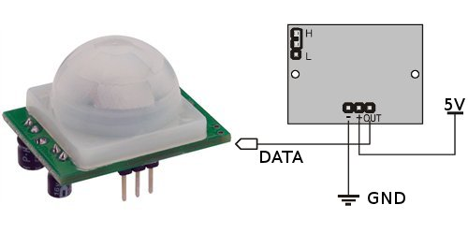
Infrared motion sensor Design
5v Power
Ground
1 Bit Active High Data Bit
User Definable Potentiometers
Sensitivity
Rate of (detection?)
SignalSenders

Slide 9
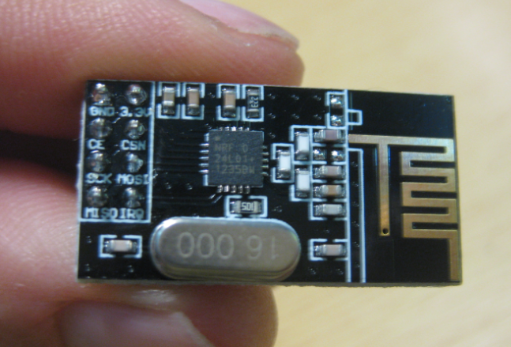
Radio frequency Communication
SPI interfacing with C
CE
CS
MOSI
MISO
SCK
Configurable through Programming
“RF24” Libraries.
Handles All RF Tasks
2.4 GHz ISM Band
Worldwide license-free
Communication Pipes
A Unique Pipe for Each Units Communication
Simultaneous Unit Communication
SignalSenders

Slide 10
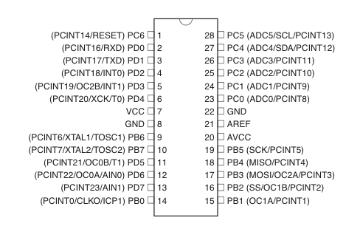
Microcontroller Programming
ATMEGA 328P
Programming
IR Detect
RF SPI
Four LED
Unit Identification
Programmed Through SPI
SignalSenders

Slide 11
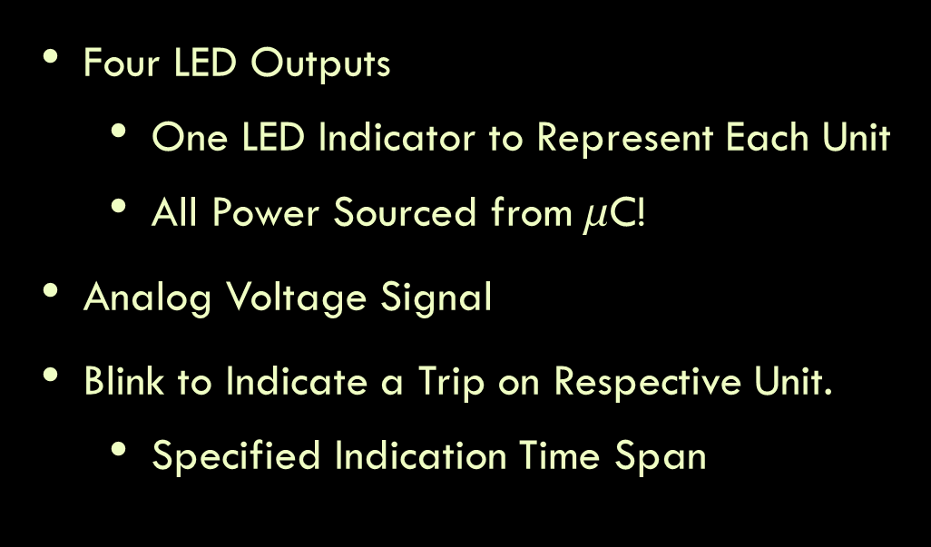
LED Output
Four LED Outputs
One LED Indicator to Represent Each Unit
All Power Sourced from $$C!
Analog Voltage Signal
Blink to Indicate a Trip on Respective Unit.
Specified Indication Time Span
SignalSenders

Slide 12
Verification
Subsections of circuit were built and tested on breadboard
Changes such as digital output pins used, SPI connectivity, etc. stemmed from early verification work

Slide 13
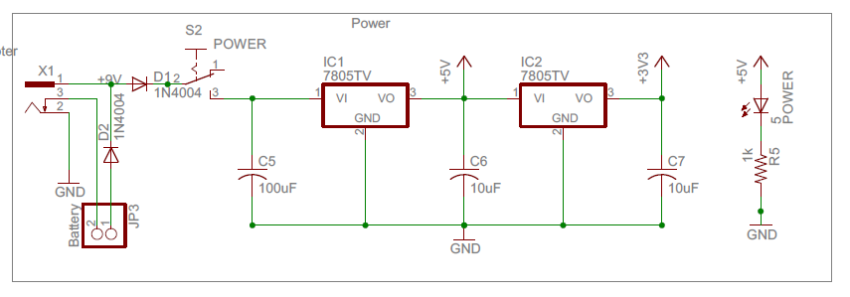
Implementation Schematic - POWER
SignalSenders

Slide 14
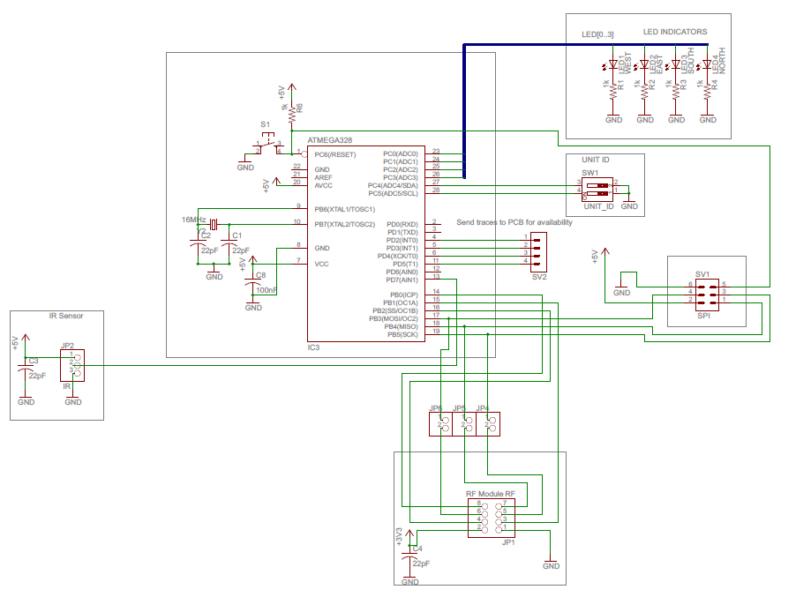
Implementation Schematic – Modules
SignalSenders

Slide 15
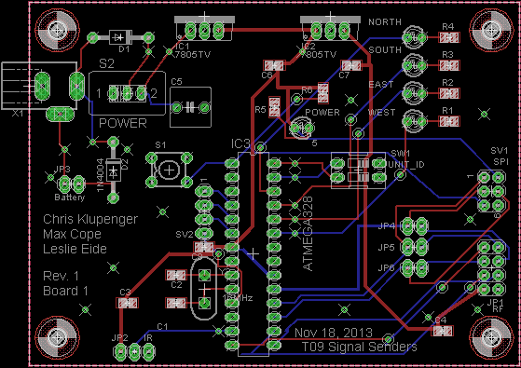
Implementation PCB
SignalSenders

Slide 16
Intellectual property prior work
RF Module libraries found online
Open source Arduino coding
Nothing proprietary created
No schematics followed
SignalSenders

Slide 17
Testing
Strategy
Execution
Testing power
Continuity
Layering complexity
Talk about issues/lack there of
SignalSenders

Slide 18
Results
4 working units (video potential?)
SignalSenders

Slide 19
Contributions
Max cope
Leslie Eide
Chris Klupenger
RF signals
RF Firmware
IR motion detector
LED output panel
Microcontroller
Programming
SignalSenders

Slide 20
Lessons Learned
SignalSenders

